Slide 1


#498
Glorify Thy Name
荣耀主圣名

Slide 2

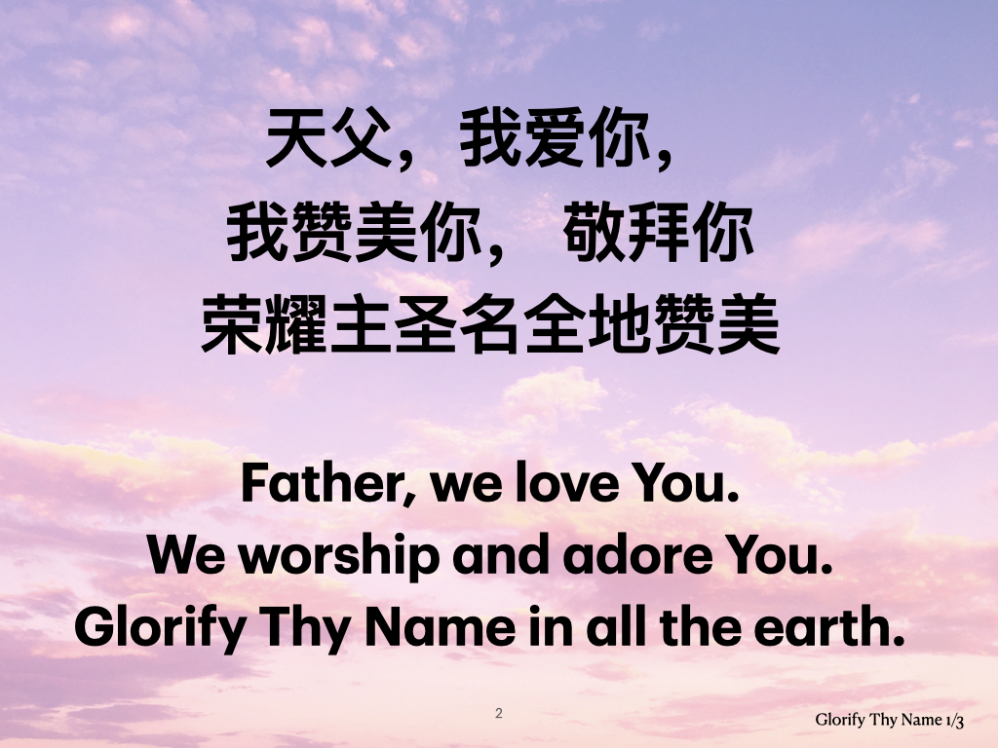
天父，我爱你，
我赞美你， 敬拜你
荣耀主圣名全地赞美
Father, we love You.
We worship and adore You.
Glorify Thy Name in all the earth.
Glorify Thy Name 1/3

Slide 3
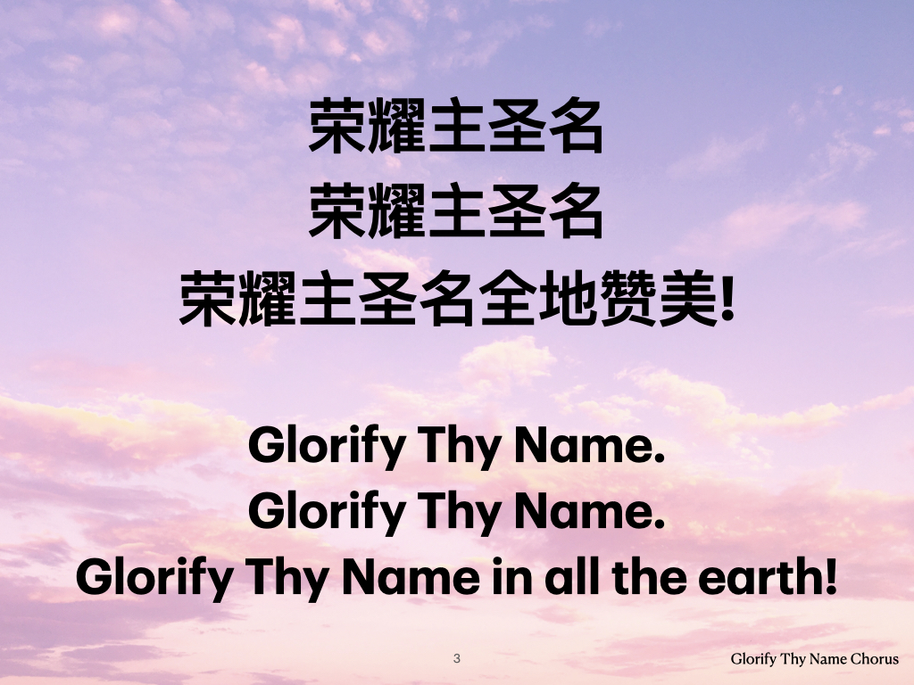
荣耀主圣名
荣耀主圣名
荣耀主圣名全地赞美!
Glorify Thy Name.
Glorify Thy Name.
Glorify Thy Name in all the earth!
Glorify Thy Name Chorus

Slide 4
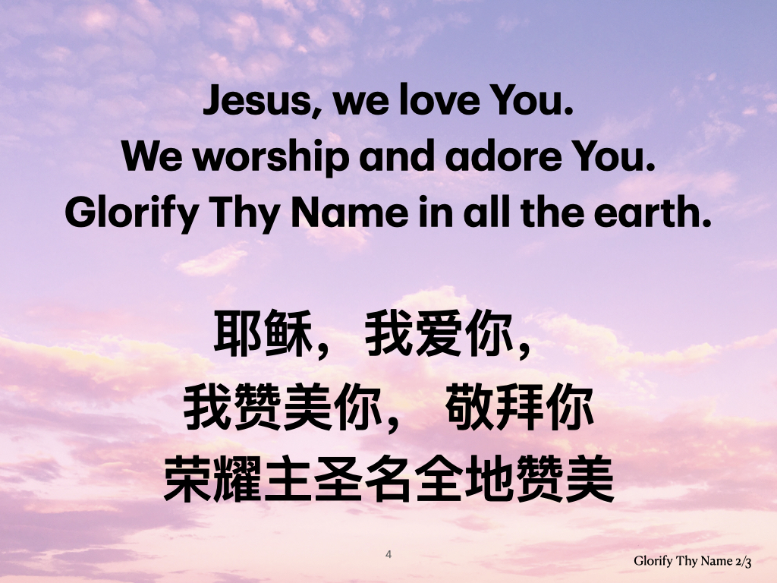
Jesus, we love You.
We worship and adore You.
Glorify Thy Name in all the earth.
耶稣，我爱你，
我赞美你， 敬拜你
荣耀主圣名全地赞美
Glorify Thy Name 2/3

Slide 5
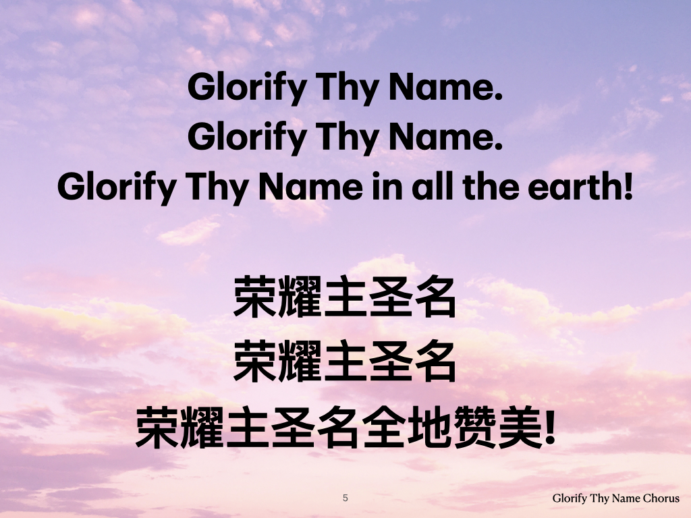
Glorify Thy Name.
Glorify Thy Name.
Glorify Thy Name in all the earth!
荣耀主圣名
荣耀主圣名
荣耀主圣名全地赞美!
Glorify Thy Name Chorus

Slide 6
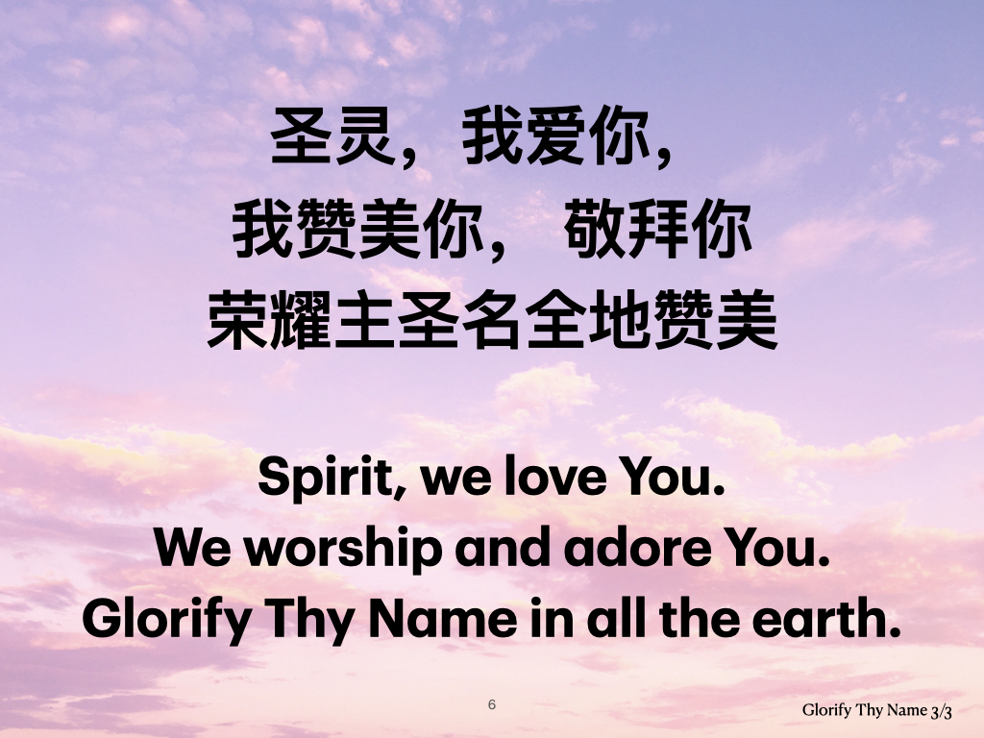
圣灵，我爱你，
我赞美你， 敬拜你
荣耀主圣名全地赞美
Spirit, we love You.
We worship and adore You.
Glorify Thy Name in all the earth.
Glorify Thy Name 3/3

Slide 7

荣耀主圣名
荣耀主圣名
荣耀主圣名全地赞美!
Glorify Thy Name.
Glorify Thy Name.
Glorify Thy Name in all the earth!
Glorify Thy Name Chorus

Slide 8
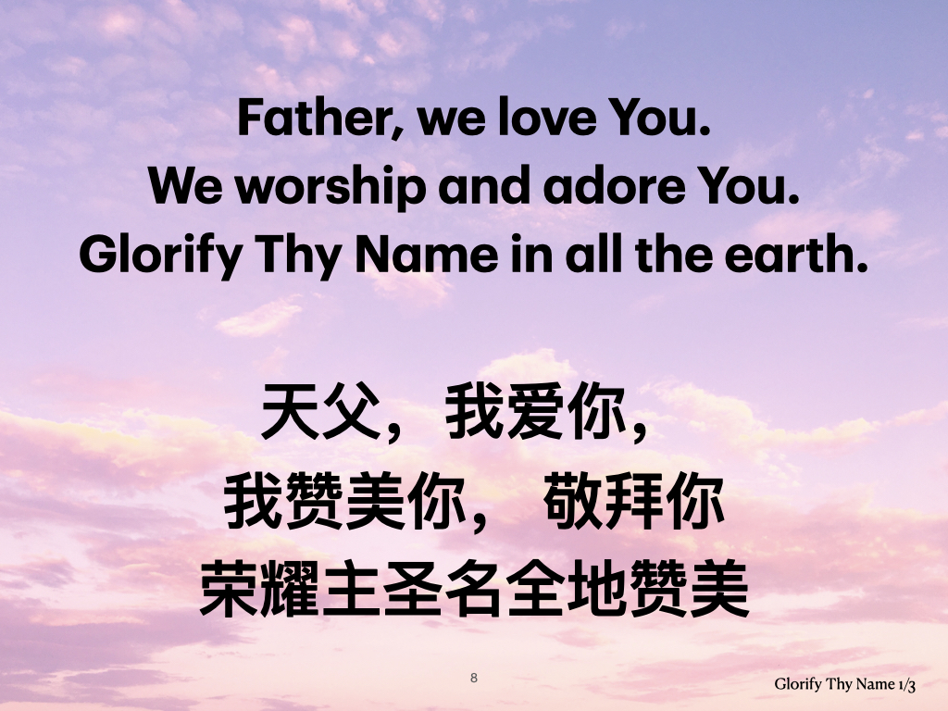
Father, we love You.
We worship and adore You.
Glorify Thy Name in all the earth.
天父，我爱你，
我赞美你， 敬拜你
荣耀主圣名全地赞美
Glorify Thy Name 1/3

Slide 9

Glorify Thy Name.
Glorify Thy Name.
Glorify Thy Name in all the earth!
荣耀主圣名
荣耀主圣名
荣耀主圣名全地赞美!
Glorify Thy Name Chorus

